Slide 1
MemoryDesk
An AI incident-response assistant that learns from past failures and successful fixes to help teams resolve new incidents faster.
Binary Minds

Slide 2
The missing piece isn't more incident data. It's usable organizational experience.
PROBLEM UNDERSTANDING & ALIGNMENT
THE INCIDENT LOOP TODAY
Incident
Investigation
Trial & Error
Resolution
↻ same issue, same effort, every time
01
02
03
Investigate from scratch
Failures get repeated
Experience stays buried
Engineers start every incident from zero, even when it has happened before.
Actions that already failed can be tried again, because nobody recorded them.
Valuable lessons sit in past incidents that are hard to find and reuse.

Slide 3
MemoryDesk — An AI teammate that remembers what worked.
PROPOSED SOLUTION & INNOVATION
FLOWCHART · HOW MEMORYDESK HANDLES AN INCIDENT
No → revise
Similar past
incident?
Human
approves?
New incident
AI understands
Yes
Recall failed ✕ +
successful ✓ actions
Recommend
action
No → fresh AI reasoning (no memory yet)
Yes
Issue
resolved?
Memory updated
next incident smarter
Store successful
action ✓
Yes
Verify
before / after
Execute
(simulated)
No
Traditional systems remember incidents.
MemoryDesk remembers the lessons inside them.
Store failed action ✕

Slide 4
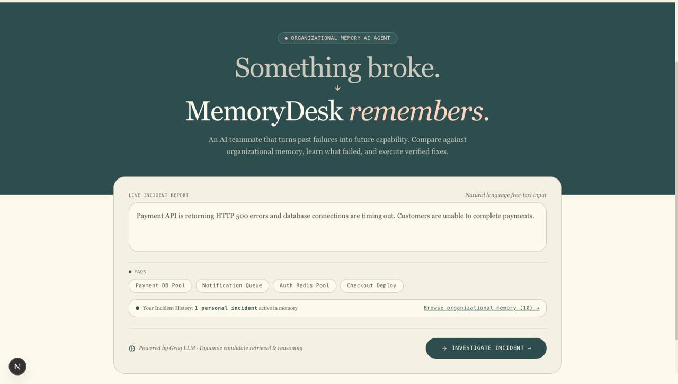
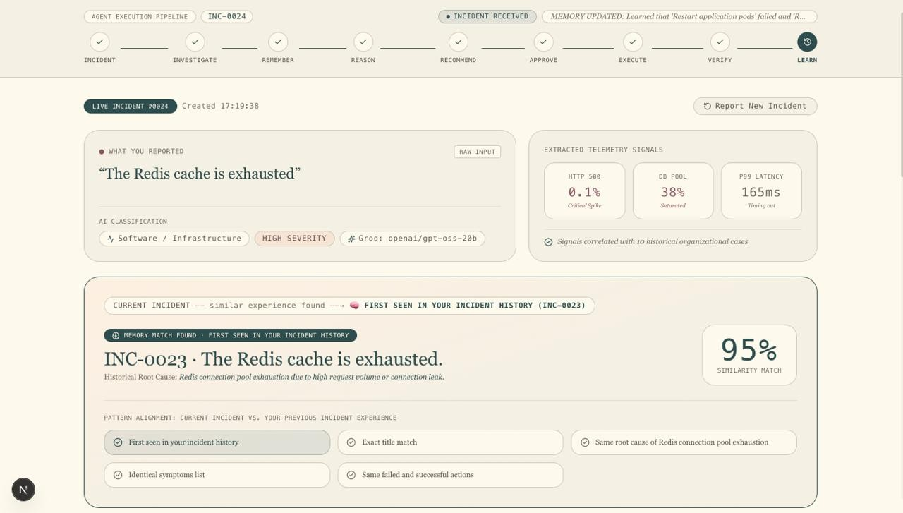
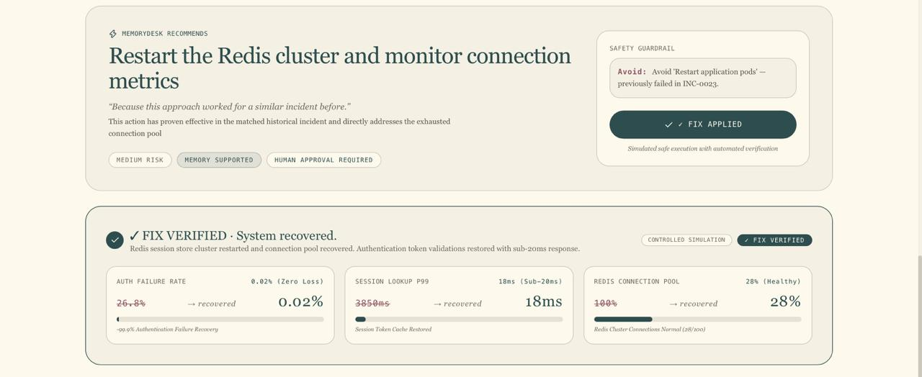
Built and running: report, remember, act, verify.
WORKING PROTOTYPE & TECHNICAL IMPLEMENTATION
SYSTEM ARCHITECTURE solid = built · dashed = future scope
PROTOTYPE SCREENS
Next.js UI incident report · approval · metrics
Prototype screenshot
1 REPORT
FastAPI backend API layer
Prototype screenshot
LANGGRAPH AGENT
human approval before any action
2 REMEMBER + REASON
Understand
Recall
Recommend
Approve
Act
Verify
Groq LLM
reasoning
Hindsight
experience memory
PostgreSQL
incidents · outcomes
Simulated env.
safe remediation
Prototype screenshot
3 ACT + VERIFY
FUTURE SCOPE · observability · ticketing · controlled infrastructure tools
Notes:
Screenshot slots (right): replace each dashed box with a real screenshot.
1 REPORT: user describes an incident in natural language.
2 REMEMBER + REASON: incident match, similarity, failed action, successful action, AI recommendation.
3 ACT + VERIFY: human approval, simulated execution, before/after metrics, verification, new memory.
Stack: Next.js, FastAPI, Groq LLM, LangGraph, PostgreSQL, Hindsight. Controlled simulated environment for safe remediation and verification.

Slide 5
Every incident makes the next one smarter.
IMPACT · DIFFERENTIATION · SCALABILITY
WORKFLOW · THE LEARNING LOOP
IMPACT
Incident
Turns previous incident experience into actionable guidance.
Remember
Investigate
↻ next incident
starts smarter
DIFFERENTIATION
Remembers failed and successful actions, and uses their outcomes to influence the next recommendation.
Verify
Learn
SCALABILITY
Act
Prototype today: simulated incidents and remediation. Later: connect observability, ticketing and controlled infrastructure tools.
WHAT MEMORYDESK STORES FROM EACH INCIDENT
Next incident: the stored outcomes shape the recommendation.
Incident
Failed action ✕
Successful action ✓
Verified outcome
New memory

